Slide 1
Unit- 2
Consignment Accounts

Slide 2
Meaning of consignment
a batch of goods destined for or delivered to someone.
"consign" means "to send"

Slide 3
Consignor
The owner of the goods who sends the goods to an agent for sale.
Consignee
Who sells the goods for the consignor.
Sells the goods and collects the money from the customers.
Will pay the consignor the net proceeds (Proceeds – Expenses – Commission) and provide the consignor an account sales showing all the proceeds and expenses.
Goods sent on consignment
Goods sent on consignment are the property of the consignor until the goods are sold.
The consignor should include all the unsold goods on consignment in his closing stock.

Slide 4
Consignment
Consignor
Consignee
Owner of the goods and also called as principal
Is the seller of the goods and also called as agent

Slide 5
whats does they do
Consignor does
Sends goods
to consignee
to sell them
On his behalf
On commission basis
Consignee does
Receive goods
From consignor
sell them to customers
On cash or credit basis
gets commission and reimbursemenr of his expense.

Slide 6
Different types of commission given to consignee under consignment
Such commission is paid in lieu of services rendered by the consignee in the form of selling the goods. Theoretically, there are three types of commission:
Ordinarycommission:
Ordinary commission is the fixed % of commission paid by the consignor to the consignee
calculated on the total sales made by the consignee.
Del Credere Commission:
It is a special commission given by the consignor to the consignee.
generally consignee is not allowed to sale goods on credit basis.
If he is allowed to sell goods on credit he is held responsible to collect money from debtors
When this commission is paid, the consignee has to bear the loss of bad debts

Slide 7
Overriding Commission:
Commission given to the consignee in addition to the normal commission
Purpose of such incentive is to motivate the consignee to create market for new products.
Sometimes, this additional commission is allowed to consignee where certain sales limits have been exceeded.

Slide 8
Pro-forma invoice
A Pro-forma invoice is a document prepared by the consignor which is sent to the consignee along with the goods. It contains the details with respect to the quantity of goods sent, rates at which the goods are sent and other terms and conditions for sending the goods on consignment.

Slide 9
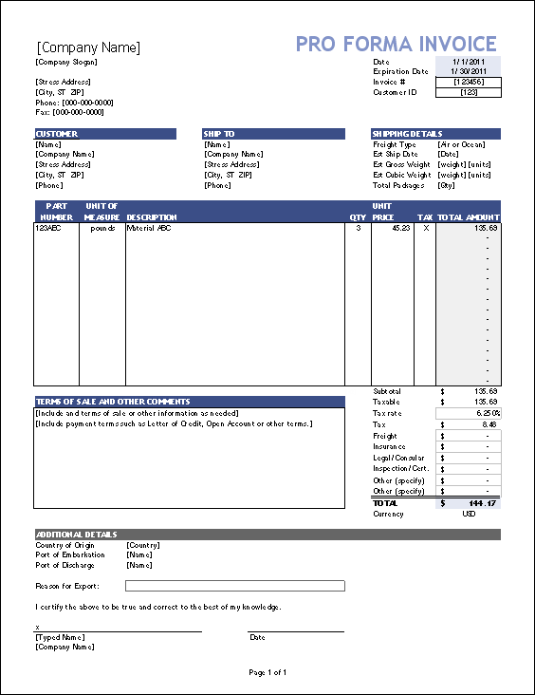

Slide 10
Account sale
Account Sales. An Account sale is a statement prepared and sent by the consignee to the consignor. It contains the details with regard to the quantity of goods received, sales made, expenses incurred, commission, amount sent and the balance payable by consignee to the consignor.

Slide 11
Difference
PROFORMA INVOICE
ACCOUNT SALE
It is prepared by the consignor and send along with the goods send on consignment The instrument contains a description of goods, i.e. quantity, price, weight, kind and other specifications. It is a declaration by the seller to provide the products and services to the buyer on the specified date and price.
Account sales is a report or statement that shows the price at which the goods are sold, expenses incurred by the consignee on behalf of the consignor, consignee's commission and the net balance for which the consignee is liable.

Slide 12
Format of Account sale Account sale statement of ……..
Particular | Amount
Sales | xxxxx
Less: expenses | xxx
commission | Xxx
 | XXXXX
Less: advance if any | Xxx
Balance due and enclosed draft | XXXXX

Slide 13
Difference
Consignment
Sale
When the goods are delivered to the agent by the owner for selling purposes, is known as Consignment.
Consignor and Consignee are the parties in the consignment
Relationship between parties Principal and Agent
Possession is transferred, but ownership is not transferred, until they are sold to the final consumer.
The consignee can return the unsold stock to the consignor.
Risk of loss is borne by consignor
Expenses incurred are met by consignor
Consideration is the Commission to the agent.
When the goods are delivered to the agent by the owner for selling purposes, is known as Consignment.
Seller and Buyer are the parties in the consignment
Relationship between parties Creditor and Debtor
Possession and ownership Both are transferred with the transfer of goods.
The buyer cannot return the goods to the seller until and unless the seller agrees to the same.
Risk of loss is borne by buyer
Expenses incurred are met by buyer
Consideration is the Profit to the seller.

Slide 14
Accounting treatment :
Transcations | In the books of consignor | In the books of consignee
Goods sent on consignment | Consignment a/c dr To goods sent of consignment | No entry
For expenses incurred by consignor | Consignment a/c dr To Bank a/c | No entry
For the advance paid by the consignee | Bank/ Bill receivable a/c dr To consignee a/c | Consignor a/ dr To Bank/ Bills payable
When consignor get the bills discounted with the bank | Bank a/c dr Discount a/c dr To Bills Receivable a/c | No entry
For the expenses incurred by the consignee | Consignment a/c dr To consignee a/c | consignor a/c dr To bank a/c
For the sales made by consignee | Consignee/ consignment debtors a/c dr To consignment a/c | Bank a/c dr To consignor
For the commission payable to the consignee | Consignment a/c dr To consignee a/c | consignor a/c dr To commission a/c

Slide 15
Transcations | In the books of consignor | In the books of consignee
For consignment stock (unsold stock) | Consignment a/c dr To consignment a/c | No entry
For profit on consignment | Consignment a/c dr To profit/ loss a/c | No entry
For loss on consignment | Profit /loss a/c dr To consignment | No entry
For abnormal loss | Abnormal loss a/c dr To consignment a/c | No entry
For removing loading in invoice price when the goods sent on invoice price | Goods sent on consignment a/c dr consignment a/c | No entry
For removing loading in consignment stock | Consignment a/c dr To consignment stock reserve a/c | No entry
For del credere commission given by consignor------bad debts borne by consignee | No entry | Bad debt a/c dr To Commission a/c
For delcredere commission not paid by the consignor------- loss of bad debts borne by consignor | Bad debts a/c dr To consignment debtor’s a/c | No entry

Slide 16
Valuation of consignment/closing/unsold stock
Particulars
Amount
Value of unsold stock ( unsold units* price per unit)
Add: proportionate direct/non recurring expenses of consignor
Add: proportionate direct/non recurring expenses of consignee Total
Note: (Direct/ non-recurring)
1) All the expenses incurred by consignor are included in direct expenses
2) In case of consignee till the goods reached to the godown of consignee the expenses incurred are direct. Rest will be indirect
xxxx
xxx
xxxx xxx
xxxx

Slide 17
Special items treatment:
Abnormal loss:
This type of loss is an avoidable loss because it does not arise due to the nature of the goods. Such loss may arise due to hard luck of consignor (i.e. destruction of goods by fire, an accident or theft). Such losses are more or less abnormal and, in any case, do not occur frequently.
Note: calculation of abnormal loss is similar to that of consignment stock
Invoice price: when the goods are sent to consignee at a price higher than the cost price ,it is termed as invoice price. (Cost Price + Profit)

Slide 18
ledger’s to be maintained under consignment
In the books of consignor
Consignment a/c ( Nature of a/c: Nominal account)
Consignee a/c ( Nature of a/c: Personal account)
Goods sent on consignment a/c ( Nature of a/c: Real account)
In the books of consignee
Consignor a/c ( Nature of a/c: Personal account)
Commission a/c ( Nature of a/c: Nominal account)

Slide 19
In the books of consignor
Consignment a/c
Particulars | Amount | Particulars | Amount
To goods sent on consignment | Xxxx | By Consignee(sale) | Xxxx
To Bank (expenses of consignor) | Xxxx | By consignment stock (unsold stock) | xxxx
To consignee (expenses & commission) | Xxxx | By goods sent on consignement (loading in gsc) | Xxxx
To consignment stock reserve (loading in unsold stock) | xxxx
To profit and loss a/c (profit) | Xxxx
 | Xxxx |  | Xxxxx

Slide 20
Consignee a/c
Particulars | Amount | Particulars | Amount
To consignment (sale) | Xxxx | By Bank / B/R (advance) | Xxxx
 |  | By consignment (expenses) | xxxx
 |  | By consignment (commission) | Xxxx
 |  | By Bank / B/R (final remittance) | xxxx
 | Xxxx |  | Xxxxx

Slide 21
Goods sent on consignment a/c
Particulars | Amount | Particulars | Amount
To consignment (loading) | Xxxx | By consignment | Xxxx
To Trading / Pruchases a/c | xxxx
 | Xxxx |  | Xxxxx

Slide 22
In the books of consignee
Consignor a/c
Particulars | Amount | Particulars | Amount
By Bank / B/P (advance) | Xxxx | By Bank (sale) | xxxx
By Bank (expenses) | xxxx
By Commission | Xxxx
By Bank / B/P (final remittance) | xxxx
 | xxxx |  | Xxxxx
Commission a/c
Particulars | Amount | Particulars | Amount
By Bad debts | Xxxx | By consignor | xxxx
By profit / loss a/c | xxxx
 | xxxx |  | Xxxxx

