Slide 1
LASER
PRESENTED BY
Sanjeev Kumar Singh
Dept. of Physics
Avanthi Degree & P.G College

Slide 2
LASER AND ITS APPLICATION
Laser
(Light Amplification by Stimulated
Emission of Radiation)

Slide 3
CONTENT
HISTORY OF LASER
BRIEF INTRODUCTION OF LASER
BASIC COMPONENTS OF LASER
CONSTRUCTION
WORKING

Slide 4
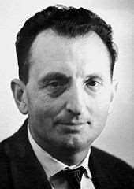
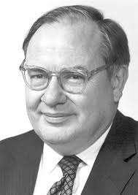
HISTORY & THE DISCOVERY OF LASER.
 The maser which is the predecessor of the laser and emitted microwaves was first built in 1953. Some of the first work done on the laser was started in 1957 by Charles Hard Townes and
Arthur Leonard’ at Bell labs. Their original work was with infrared frequencies but they later changed their focus to visible light and the optical maser which was how the Laser was first referred to. Working independently of Townes and Schawlow and of each were Gordon Gould a graduated student at Columbia University and Aleksandr Milkhailovich Prokhorov. All parties had the idea of using an open resonator which became an important part of the laser. In 1959 Gould applied to the US patent officer for a patent for the Laser but he was refused and the patent instead went to bell laboratories in 1960. The first working laser was built by Theodor Harold Maiman working at Hughes Research laboratories in Malibu California.
Charles Hard Townes
Arthur Leonard

Slide 5
The LASER beam was invented by the physicist MAIMAN in 1960
 One of the most influential technological achievements of the 20th century
Lasers are basically excited light waves

Slide 6
BRIEF INTRODUCTION ABOUT
LASER

Slide 7
A laser is a device that emits light through a process of optical amplification based on
the stimulated emission of electromagnetic radiation. The term "laser" originated as an acronym for "light amplification by
stimulated emission of radiation. A laser differs from other sources of light in that it emits light coherently.

Slide 8
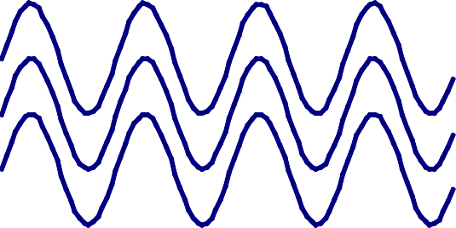
CHARACTERISTICS OF LASER LIGHT
MONOCHROMATIC DIRECTIONAL
COHERENT
The combination of these three properties makes laser light focus 100 times better than ordinary light

Slide 9
Metastable State
2. The higher state must be a metastable state – a state in which the electrons remain longer than usual so that the transition to the lower state occurs by stimulated emission rather than spontaneously. And the population inversion occur.
E₃
E₃
E₂
E₂
Metastable state
Incident photon
E₂ − E₁
Photon of energy
E₁
E₁Emitted photon
Metastable system
Stimulated emission

Slide 10
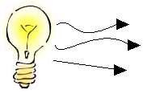
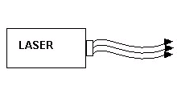
Incandescent vs. Laser Light
10
Many wavelengths
Multidirectional
Incoherent
Monochromatic
Directional
Coherent

Slide 11
ELECTROMAGNETIC SPECTRUM
Visible
Radio
Gamma Ray X-ray
Ultraviolet
Infrared
Microwaves
Radio
Short Wavelength
Long Wavelength
Lasers operate in the ultraviolet, visible, and infrared.

Slide 12
LASER SPECTRUM
Gamma Rays
X-Rays
Ultra- Visible violet
Infrared
Micro- Radar waves waves
TV Radio waves waves
₁₀-13 ₁₀-12 ₁₀-11 ₁₀-10 ₁₀-9 ₁₀-8 ₁₀-7 ₁₀-6 ₁₀-5 ₁₀-4 ₁₀-3 ₁₀-2 ₁₀-1
1
10
10²
Wavelength (m)
LASERS
Retinal Hazard Region
Visible Near Infrared
Ultraviolet
Far Infrared
200 300
400 500 600 700 800 900 1000 1100 1200 1300 1400 1500
10600
Wavelength (nm)
Communication Diode
ArF 193
XeCl 308
HeNe Ruby
633 694
CO₂ 10600
KrF 248
Ar 2ω 488/515 Nd:YA
G
532
Alexandrite GaAs 755 905
Nd:YAG 1064
1550
Laser-Professionals.com

Slide 13
LASER COMPONENTS
ACTIVE MEDIUM
Solid (Crystal)
Gas Semiconductor (Diode)
Liquid (Dye)
Optical Resonator
Output Beam
Active Medium
EXCITATION
MECHANISM
Optical Electrical Chemical
High Reflectance Mirror (HR)
Output Coupler Mirror (OC)
Excitation
Mechanism
The Active Medium contains atoms which can emit light by
stimulated emission.
OPTICAL RESONATOR
HR Mirror and Output Coupler
The Excitation Mechanism is a source of energy to excite the atoms to the proper energy state.
The Optical Resonator reflects the laser beam through the
active medium for amplification.

Slide 14
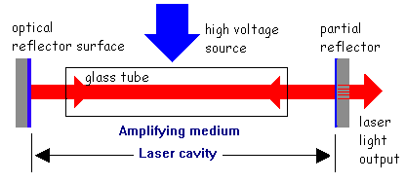
 The beam of light is reflected back and forth along the central tube, until the waves of light become coherent.

Slide 15
Mechanism of laser emission
Absorption
E₁
E₂

Slide 16
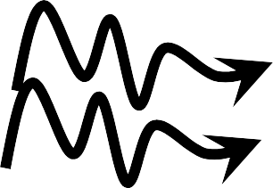
STIMULATED EMISSION
Spontaneous Emission
&

Slide 17
Classification of laser acc. To production technique
Optically Pumped Solid-State Lasers
Ruby Laser
Rare Earth Ion Lasers
Nd: YAG Lasers.
Nd: Glass Lasers
Tunable Solid-State lasers
Liquid (Dye) Lasers
Gas Lasers
Semiconductor Lasers
Free Electron Lasers
X-ray Lasers, and
Chemical Lasers

Slide 18
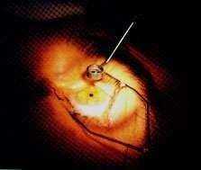
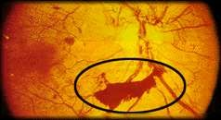
USES AND APPLICATION
 In medicine
 to break up gallstones and kidney stones,
 to weld broken tissue (e.g. detached retina)
 to destroy cancerous and precancerous cells; at the same time, the heat seal off capillaries,
 to remove plaque clogging human arteries.
 used to measure blood cell diameter
 Fiber-optic laser catheter is in the treatment of bleeding
ulcers.
 can photocoagulate blood
 can also be used for dental treatment.

Slide 19
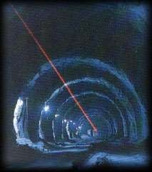
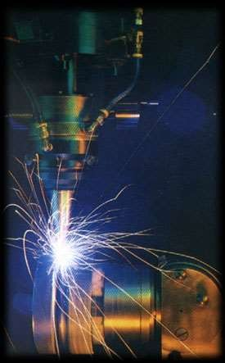
In industry
 to drill tiny holes in hard materials,
 for welding and machining,
 for lining up equipment precisely, especially in
inaccessible places

Slide 20
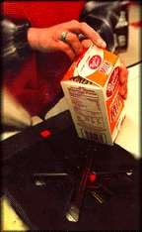
 to be used as bar-code readers,
 In everyday life
 to be used in compact disc players,
 to produce short pulses of light used in digital
communications,
 to produce holograms.

Slide 21
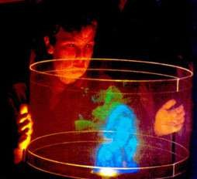
Holography
 Holography is the production of holograms by the use of laser.
 A hologram is a 3D image recorded in a special photographic plate.
 The image appears to float in space and to move when the viewer moves.

Slide 22
Research
used to measure the speed of light in a laboratory

Slide 23
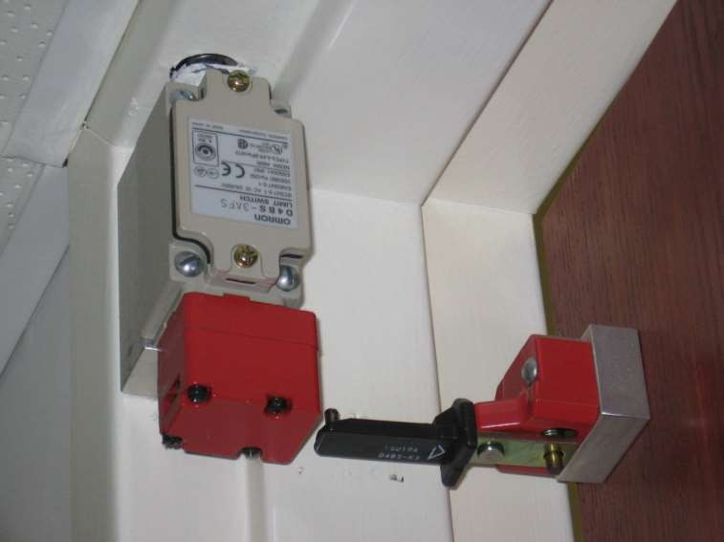
LABORATORY DOOR INTERLOCK

Slide 24
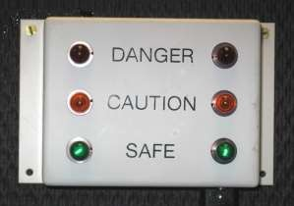
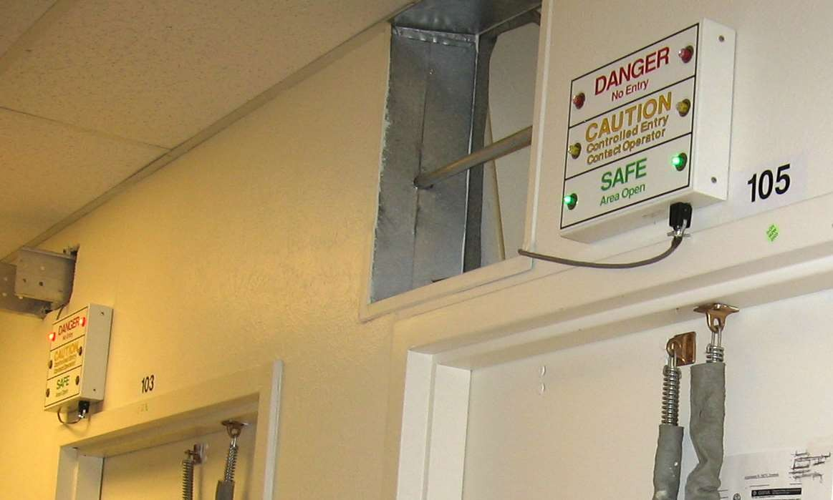
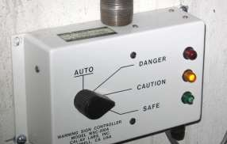
ENTRYWAY WARNING LIGHTS

Slide 25
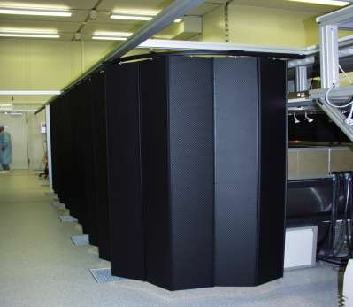
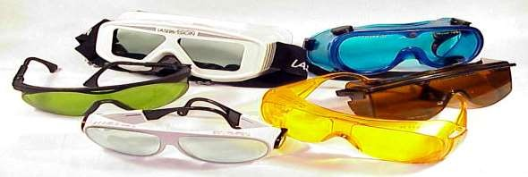
LASER PROTECTIVE BARRIERS AND SAFETY EYEWEAR

Slide 26
Conclusion
 Laser communication in space has long been a goal for NASA because it would enable data transmission rates that are 10 to 1,000 times higher than traditional radio waves.
 While lasers and radio transmissions both travel at light-speed, lasers can pack more data. It's similar to moving from a dial-up Internet connection to broadband.
Astronomers could use lasers like very accurate rulers to measure the movement of planets with unprecedented precision.
With microwaves, we're limited to numbers like a meter or two in distance, whereas [lasers have] a potential for getting down into well beyond the centimeter range.

Slide 27
THANK YOU

