Slide 1
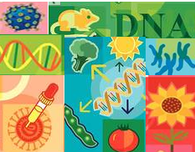
Genetic Engineering
Presented by
Dr Jasmine
Microbiology

Slide 2
Lesson Objectives
At the end of this lesson you should be able to
Define Genetic Engineering
Outline the process of genetic engineering involving some or all of the following: isolation, cutting, transformation, introduction of base sequence changes and expression
Know three applications: one plant, one animal, one micro-organism

Slide 3
Genetic Engineering
The simple addition, deletion, or manipulation of a single trait in an organism to create a desired change.

Slide 4
Genetic Engineering What you need to know
Manipulation and alteration of genes
Three applications: one plant, one animal, one micro-organism
Process involving
isolation, transformation,
and expression

Slide 5
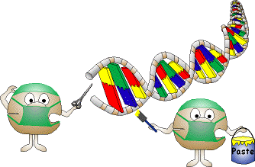
Genetic Engineering
Is:
Artificially copying a piece of DNA from one organism and joining this copy of DNA into the DNA of another organism
www.clipartguide.com
Notes:
Modern biotechnology relies on newer techniques, such as genetic engineering, to incorporate genetic material from one living organism into another.
The DNA is cut from the donor cell and inserted into the DNA of another organism (vector) e.g. bacterium.
The bacterium will then manufacture the protein coded for by the gene.
Products of biotechnology include medications, human insulin, and enzymes used in laundry detergents and cheese-making.
More recently, the use of biotechnology has led to new pesticide products that control a variety of pests.

Slide 6
Purpose of Genetic Engineering
It allows genes from one organism to be inserted into a cell of a different organism of a different species.
Examples:
Human genes can be inserted into a bacterium
Human genes can be inserted into cells from other animals
Bacterium genes can be inserted into plant cells

Slide 7
Genetic Engineering
Genetic engineering means that DNA from different organisms can be combined
Bacteria can be engineered to produce human proteins
Human genes can be inserted into other animals

Slide 8
Genetic Engineering - Overview
The altered DNA is called recombinant DNA
Recombinant DNA is joined to other unrelated DNA in the organism
This is called gene splicing.
- tiny segments of a gene are taken out and replaced by different genes

Slide 9
Learning Check
What is Genetic Engineering?
What is the purpose of Genetic Reengineering?
Give three examples of Genetic Engineering
What is the difference between altered and recombinant DNA?
What is meant by gene splicing?

Slide 10
Transgenic Organisms
Organisms altered by genetic engineering.
Genetic material changed by other than random natural breeding
Gene transfer
-moving a gene from one organism to another.

Slide 11
What Transgenic means
'Trans-' means 'crossing from one place to another‘
The '-genic' bit means genes
So it means that bits of genes from different living things have been bolted together and spliced into another organism to make a new one which does something which the scientists want it to do.

Slide 12
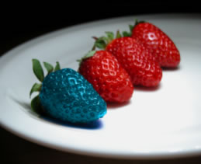
Examples of Transgenic Organisms
GMO- genetically modified organism
GEO-genetically enhanced organism
For example
Plants that resists a particular type of weed killer
Sheep which makes some special substance in its milk.
https://www.healthproductsguru.com

Slide 13
Learning Check
What the word transgenic mean?
What is a transgenic organism?
Give examples of transgenic organisms

Slide 14
5 Stages involved in GE
Isolation
Cutting
Ligation and Insertion
Transformation
Expression

Slide 15
1. Isolation
(a) Isolation of a specific gene from donor e.g. human
Cells broken open
Genetic probe added
Reveals position of the gene of interest
Genetic probe
Position of gene of interest
Donor DNA
Notes:
The first step involves breaking open the cells of the donor to release the DNA and isolate the gene of interest e.g. insulin producing gene.
Cells are broken open using chemicals and enzymes e.g. washing up liquid
Donor DNA is extracted
Genetic probe is added
A DNA probe consists of a small fragment of DNA labelled with an enzyme, a radioactive tag or a flurescent dye tag.
The probe will bind to a complementary DNA sequence by base pairing.
Identifying the presence and location of the gene of interest

Slide 16
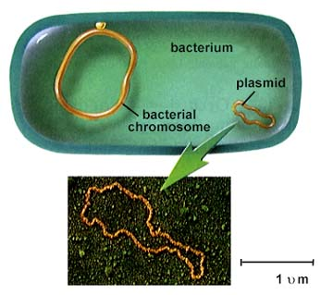
1. Isolation
(b) Isolation of plasmid from a bacterial cell
Bacterial cell
Plasmid
www.sci.sdsu.edu
Notes:
The DNA from the bactterial cell is released.
A bacterial cell contains a circular loop of DNA called a plasmid.
The plasmid is isolated from the bacterial cell.
The plasmid will act as a vector for carrying a new gene i.e. the gene from the donor will be inserted into the plasmid DNA..

Slide 17
2. Cutting
Restriction enzymes act as molecular scissors and cut DNA at specific sites called restriction sites
Restriction site
Restriction site
Restriction ezymes
Clipartguide.com
Notes:
The donor DNA and plasmid DNA are cut using enzymes called restriction enzymes.
Restriction enzymes recognise specific sequence of bases
Act as a molecular scissors to cut the DNA strand within the recognition sequence.
The donor DNA and plasmid DNA are cut using the same restriction enzymes.
Bacteria use restriction enzymes to defend themselves against attacks from bacterial viruses. The enzymes cut invading viral DNA and render it harmless.

Slide 18
2. Cutting
Restriction site
Restriction site
Donor DNA
Plasmid
Restriction enzymes
© Biology Support Service 2007

Slide 19
Cutting
Donor DNA
Plasmid
Sticky Ends
Notes:
Restriction enzymes cut the DNA from the donor at specific points
The cut ends have sticky ends
The same restriction enzymes cut the DNA from the plasmid also revealing sticky ends
As a result of cutting by the restriction enzymes the donor DNA and the plasmid are left with unpaired bases known as sticky ends.

Slide 20
DNA Ligase
http://www.slic2.wsu.edu:82/hurlbert/micro101/pages/Chap10.html#Sticky_ended_cut
Ligation –rejoining cut fragments of DNA and forming artificial recombinant molecules

Slide 21
Ligation and Insertion

Slide 22
4. Transformation
Recombinant DNA introduced into bacterial cell
Bacterial cell
Bacterial chromosome
Recombinant DNA

Slide 23
5. Expression
Bacterial cell reproduces by Binary Fisson
Bacterial cell produces the polypeptide
Coded for by the donor DNA
Notes:
Universality of genetic code
Plasmid will produce the polypeptide coded for by the donor DNA

Slide 24
Summary of steps
Donor DNA
Plasmid
1. Cut with restriction enzymes
Donor DNA
Sticky Ends
2. Ligase bonds sticky ends together
Recombinant DNA

Slide 25
Expression
Expression is getting the organism with the recombinant DNA to produce the desired protein
When the protein is produced in large amounts it is isolated and purified

Slide 26
Learning Check
What are the stages involved in GE?
Outline what happens in the stage isolation ?
What enzyme is used to cut the DNA?
Can you explain what happens in transformation?
What is meant by gene expression?

Slide 27
Animals used in GE
The human gene to clot blood has been inserted into the DNA of sheep
Sheep produce human clotting factor needed for Haemophiliacs in their milk
Goats produce a protein to treat emphysema

Slide 28
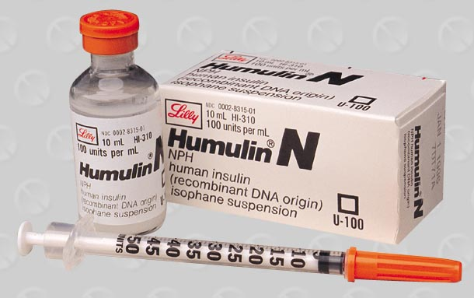
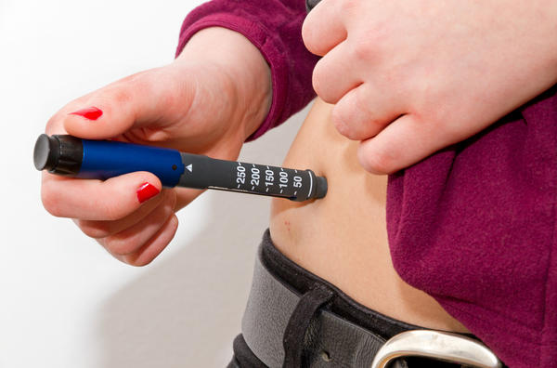
Applications (Micro-organisms)
Production of humulin
www.healthtap.com
Used by diabetics
Notes:
Insulin is a hormone that controls sugar levels in an organism.
Diabetes occurs in people when there is too little or too much insulin produced. To control diabetes, sufferers usually inject insulin once or twice daily. Until the mid-1980's most insulin was produced by extracting a human-equivalent insulin from the pancreas of animals (usually pigs).
GM insulin ( Humilin) is a genetically modified form of insulin.
The genetic sequence for insulin production is removed from human DNA. This is then inserted into the DNA of a bacteria, Escherrichia coli (E. coli).
The gene inserted into the bacteria cell is inherited from cell to cell as the cells multiply. The insulin protein is produced (expressed) by the cells. The insulin is then extracted from the cells.
Problems with BSE in Britain have made users wary of products derived from animals. GM insulin carries none of these concerns.
GM insulin is also cheaper to produce than pig-based extraction.
During the production process there are points at which contamination of the insulin mix can occur. This caused initial problems with patient reactions to these contaminants.
Some patients have reported hypoglycaemic problems after switching to GM insulin - they have lost the ability to detect the onset of hypoglycaemia. However, various studies indicate that over a third of long-term diabetics lose this ability after 10 years of treatment.

Slide 29
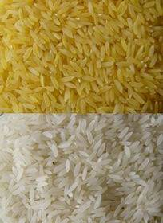
Plant Application
Golden Rice – a possible solution to Vitamin A deficiency.

Slide 30
THANK YOU

