Slide 1


P. RAMANJANEYA PRASAD
Department of Electronics
1

Slide 2







2
+1
=3
HOW THE COMPUTER GETS THE ANSWER

Slide 3



















0
0
1
1
0
1
0
1
1
0
0
1
A computer understands
information composed of only zeros and ones.
The decimal number system is convenient for the programmer.
The computer uses binary digits for its operation.

Slide 4









DECIMAL
BASIC NUMBER SYSTEM
HEXA DECIMAL
BINARY
OCTAL
4

Slide 5



DIGITS
DECIMAL NUMBER SYSTEM
0,1,2,3,4,5,6,7,8,9.
BASE
10
5

Slide 6







4*10³
DECIMAL NUMBER 4598
5*10²
9*10¹
8*10⁰
6

Slide 7


0,1
BINARY NUMBER SYSTEM
DIGITS
•2
BASE
7

Slide 8







1*2³
BINARY NUMBER 1011
0*2²
1*2¹
1*2⁰
8

Slide 9



HEXADECIMAL NUMBER SYSTEM
0,1,2,3,4,5,6,7,
8,9,A,B,C,D,E,F.
DIGITS
BASE
16
9

Slide 10






HEXADECIMAL NUMBER 1A5D
1*16 ³
A*16²
5*16¹
D*16⁰
10

Slide 11


DIGITS
OCTAL NUMBER SYSTEM
0,1,2,3,4,
5,6,7,8.
BASE
•8
11

Slide 12




5*8³
OCTAL NUMBER 5273
2*8²
7*8¹
3*8⁰
12

Slide 13



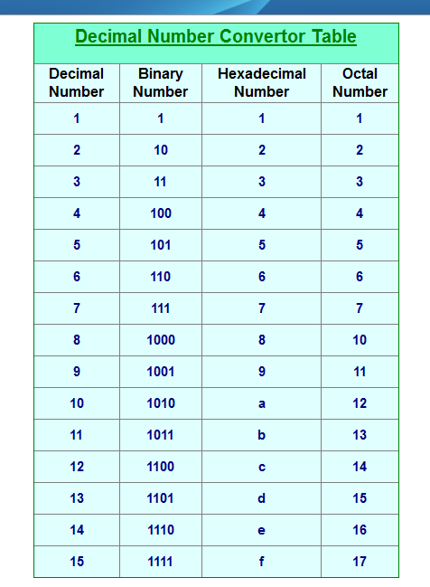
CONVERSIONS IN BASIC NUMBER SYSTEM
13

Slide 14











BINARY TO DECIMAL
BIT
POSITION
5 4 3 2 1
DECIMAL
1*2⁴+0*2³+1*2²
+0*2¹+1*2⁰.
1 0 1 0 1
21
BINARY
MUL WITH BASE
14

Slide 15









HEXADECIMAL TO DECIMAL
BIT POSITION
3 2 1
DECIMAL
1449
5A9
5*16²
+A*16¹
+9*16⁰
MUL WITH BASE
HEX
15

Slide 16









OCTAL TO DECIMAL
BIT
POSITION
3 2 1
DECIMAL
421
1
645
6*8 ²+4*8
+5*8.⁰
OCTAL
MUL WITH
BASE
16

Slide 17








DECIMAL TO BINARY
Divide through out by 2
39
Q=19
R=1
19
Q=9
R=1
9
Q=4
R=1
4
Q=2
R=0
2
Q=1
R=0
1
Q=0
R=1
LSB
MSB
DECIMAL = 39
BINARY = 100111
17

Slide 18



DECIMAL TO HEX
Divide through out by 16
35
Q=2
R=3
2
Q=0
R=2
LSB
MSB
DECIMAL = 35
HEX = 23
18

Slide 19





DECIMAL TO OCTAL
Divide through out by 8
461
Q=57
R=5
57
Q=7
R=1
7
Q=0
R=7
LSB
MSB
DECIMAL = 461
OCTAL = 715
19

Slide 20

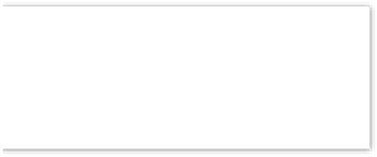




BINARY TO HEXADECIMAL
BINARY
4BITS DIV
HEX
(010111011001)²
(0101)(1101)(1001)
(5) (D) (9) =(5D9¹)⁶
20

Slide 21

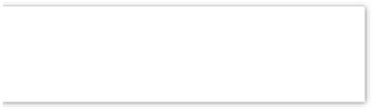






BINARY TO OCTAL
BINARY
3BIT DIV
OCTAL
(101111100) ₂
(101)(111)(100)
(5) (7) (4)
=(574)₈
21

Slide 22






HEXADECIMAL TO BINARY
HEX
(5C) ₁₆
EXPANSION
(0101)(1100)
BINARY
(01011100) ₂
22

Slide 23






OCTAL TO BINARY
OCTAL
EXPANSION
BINARY
(436) ₈
(100)(011)
(100011) ₂
23

Slide 24






HEXADECIMAL TO OCTAL
HEX
(4DF)₁₆
EXP
(0100)(1101)(1111)
BINARY
(010011010000)2
3BIT DIV
(010)(011)(011)(111)
OCTAL
(2337)₈
24

Slide 25






OCTAL TO HEXADECIMAL
OCTAL
(456) ₈
EXP
(100)(101)(110)
BINARY
(100101110)₂
4BIT DIV
(0001)(0010)(1110)
HEX
(12E) ₁₆
25

Slide 26





REPRESENTATION OF NEGATIVE NUMBER
9’S & 10’S COMPLIMENT
DECIMAL NUMBER SYSTEM
1’S & 2’S COMPLIMENT
BINARY NUMBER SYSTEM

Slide 27







BINARY ARITHMETIC
BINARY ADDITION
1
BINARY SUBTRACTION
2

Slide 28








BINARY ADDITION
0 + 0 = 0
1 + 0 = 1
0 + 1 = 1
1 + 1 = 0 1 (Carry bit)
1 1 0 1
+0 0 0 1
1 1 1 0
(13 decimal)
(+1 decimal)
(14 decimal)

Slide 29









BINARY SUBTRACTION
0 ‐ 0 = 0
1 ‐ 0 = 1
0 ‐ 1 = 1 1 (Carry bit)
1 ‐ 1 = 0
Borrow
1 1 0 1
+ 0 0 1 1
1 0 1 0
(13 decimal)
(-3 decimal)
(10 decimal)
29

Slide 30

SIGNED ARITHMETIC OPERATION
MSB bit is reserved to represent the sign of
the number.
When the number is negative, the sign bit is kept one.
When the number is positive, the sign bit is 0.
In 8-bit processor, MSB = sign bit & other 7
bits = number.
In 16-bit processor, MSB = sign bit & other 15 bits = number.
30

Slide 31









EXAMPLES
0 0 0 0 0 1 0 1 (+5 decimal)
0 0 0 0 0 1 0 0 (+4 decimal)
0 0 0 0 1 0 0 1 (+9 decimal)
0 0 0 0 0 1 0 1 (+5 decimal)
1 0 0 0 0 0 1 0 (-2 decimal)
1 1 1 1 1 1 0 1 (1’comp of -2)
1
1 1 1 1 1 1 1 0 (2’s comp of -2) 2
1
2
1
0 0 0 0 0 0 1 1 (+3 decimal)

Slide 32


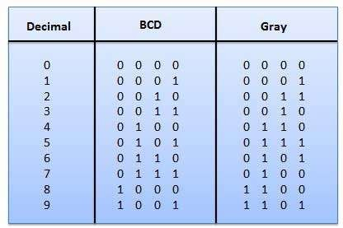
BCD AND GRAY CODE

Slide 33


LOGIC GATES
Logic gates perform basic logical functions.
They are fundamental building blocks of digital integrated circuits.
Most logic gates take an input of two binary
values, and output a single value of a 1 or 0.
Some circuits may have only a few logic gates, while others, such as microprocessors, may have millions of them.
There are seven different types of logic gates, which are outlined.
35

Slide 34
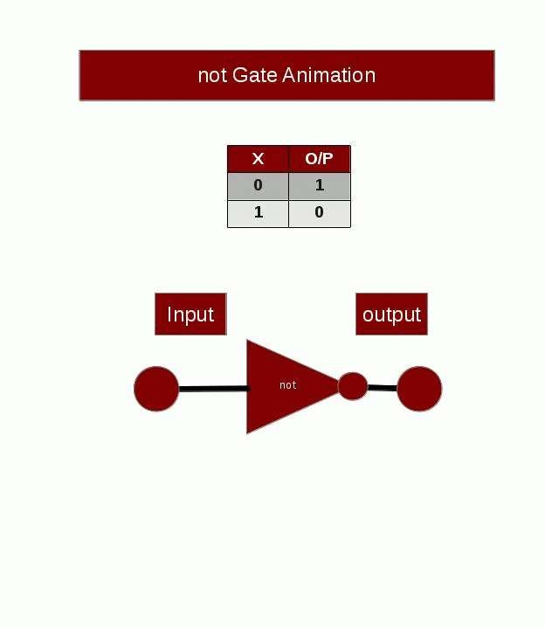
36

Slide 35
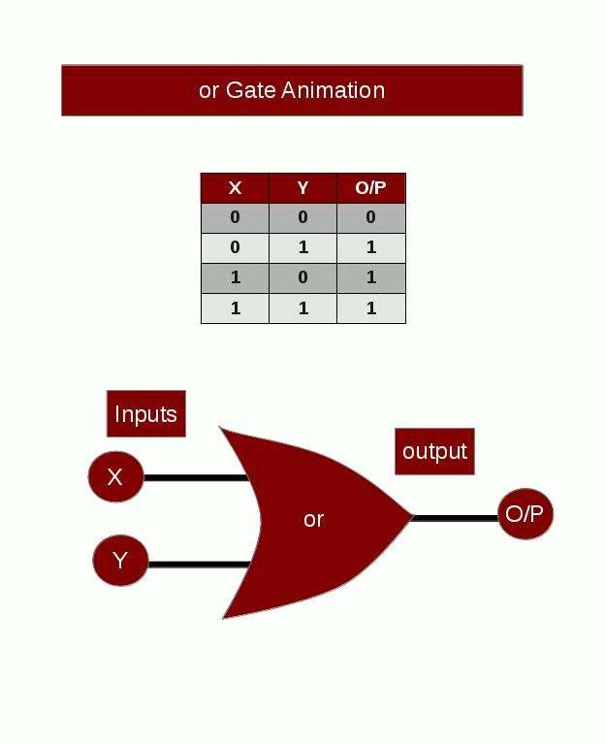
35

Slide 36
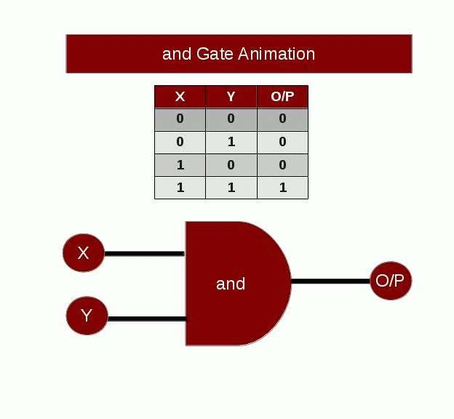
36

Slide 37
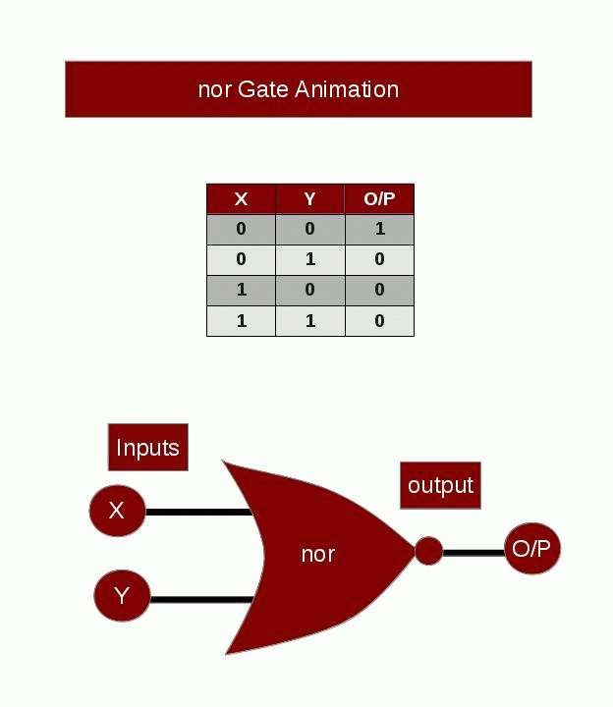

Slide 38
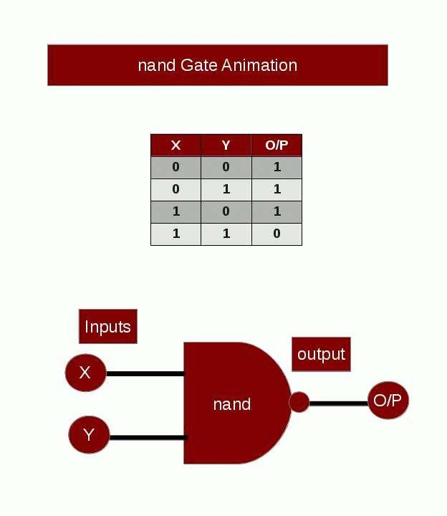

Slide 39
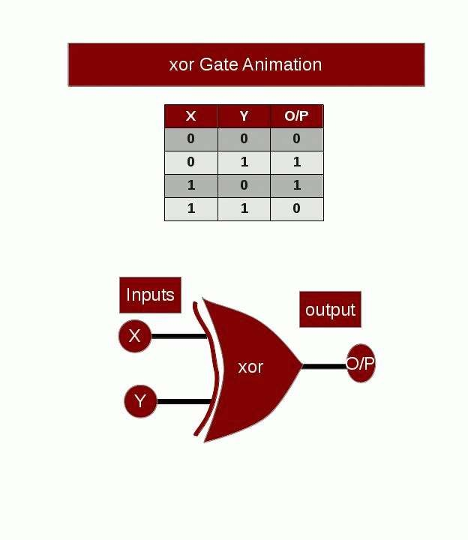

Slide 40
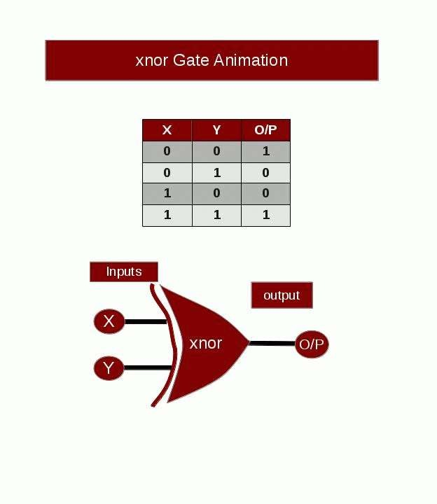
40

Slide 41
Thank you
For any clarifications on the topics you can email to prasadelectronics@avanthi.edu.in
44

