Slide 1
DEMAND

Slide 2
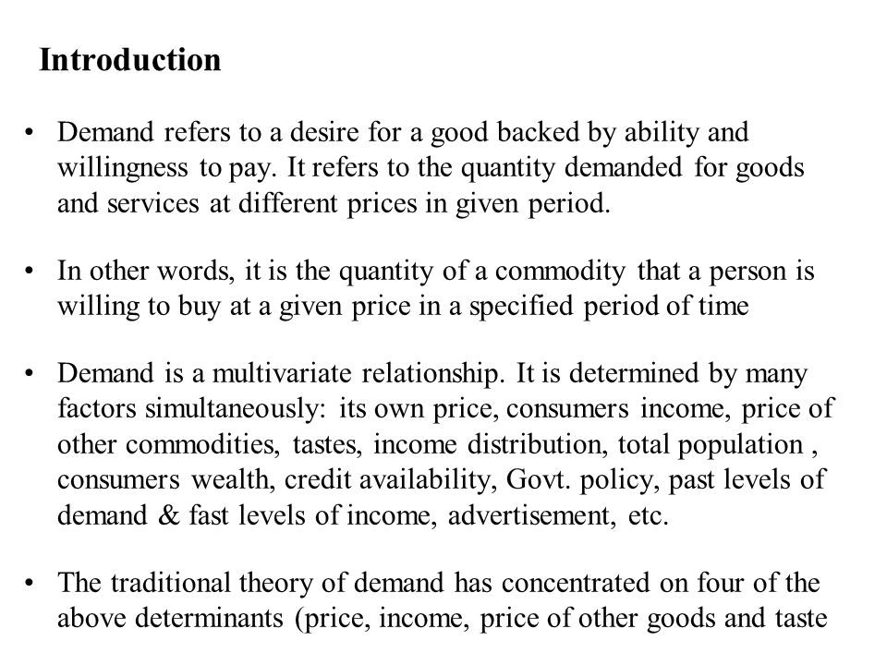
DEMAND

Slide 6
