Slide 1
Client Server Architecture

Slide 2
Content
Definition
Components
Emergence of Client server architecture
Characteristic of client server architecture
Types of client server system
Its Advantages and Disadvantages

Slide 3
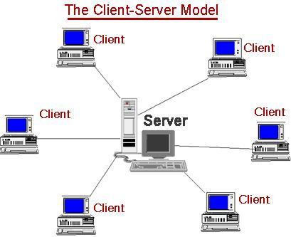
Definition
Client/server architecture is a computing model in which the server hosts, delivers and manages most of the resources and services to be consumed by the client. This type of architecture has one or more client computers connected to a central server over a network or internet connection.
Client/server architecture is also known as a networking computing model or client/server network because all the requests and services are delivered over a network.

Slide 4
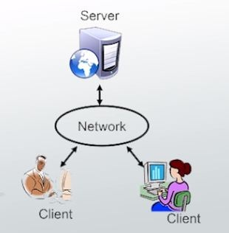
Components
Clients
Servers
Communication Networks

Slide 5
What is client
A client can be a simple application or a whole system that accesses services being provided by a server.
A client can connect to a server through different means like domain sockets, named, shared memory or through Internet protocols, which is the most common method being used since the wide adoption of the Internet.
Clients are classified into three types:
  Thin Client: A client application with minimum functions that uses the resources provided by a host computer and its job is usually just to display results processed by a server. It simply relies on a server to do most or all of its processing.
  Thick/Fat Client:. It can do most of its processing and does not necessarily rely on a central server, but may need to connect to one for some information, uploading, or to update data or the program itself.
    Anti-virus software belong to this category because they do not really need to connect to a server to do their job, although they must connect periodically to download new virus definitions and upload data.
  Hybrid: Exhibits characteristics from the two above types. It can do most processes on its own but may rely on a server for critical data or for storage.

Slide 6
What is server
Computers or processes that manage network resources
  Disk drives (file servers)
  Printers (print servers)
  Network traffic (network servers)
Example: Database Server
  A computer system that processes database queries

Slide 7
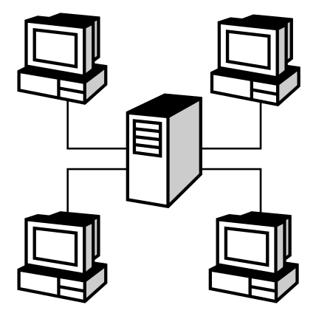


Communication Network
Servers
Networks Connect Clients and Servers
Clients
Networks

Slide 8
Emergence of Client server architecture
A long time ago, client-server computing was just using mainframes and connecting to dumb terminals.
Through the years, personal computers started to evolve and replaced these terminals but the processing is still done on the mainframes.
With the improvement in computer technology, the processing demands started to split between personal computers and mainframes.

Slide 9
Characteristics of Client-Server Architecture
There are various characteristics of client-server architecture which makes the web communication easy via applications such as
  scalability which allows to scale clients and servers horizontally or vertically.
  communication through APIs (application program interfaces) & RPCs (Remote procedure call)
  environment is heterogeneous and multivendor,
  client – server architecture provides combination of client which interacts with user & server that interacts with the shared resource, etc.
  Transparency of location
  Encapsulation of services
  Integrity

Slide 10
Advantages and disadvantages of client server architecture
Advantages
  Improved Data Sharing
  Integration of Services
  Shared Resources amongst Different Platforms
  Inter-Operation of Data
  Data Processing capability despite the location
  Easy maintenance
  Security
Disadvantages
  Overloaded servers: When there are frequent simultaneous client requests, servers severely get overloaded, forming traffic congestion.
  Impact of centralized architecture: Since its centralized if a critical server fails, client requests are not accomplished. Therefore client/server lacks robustness of a good P2P network

Slide 11
Types of Client-Server Architecture
There are various types of client-server architecture which are described as below:
The Two Tiers Architecture:
Three Tiers Architecture:
N-Tiers Architecture

Slide 12
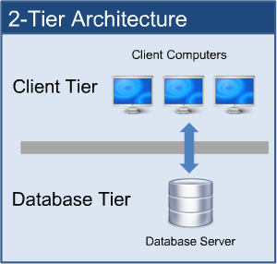
Two Tier Architecture
In this type of architecture, the workload is divided between the server (host of the system) and the client(which hosts the user interface).
In reality these are located on separate computers but there is no absolute requirement of this, providing that the tiers are logically separated can be hosted (e.g. development and testing) on the same computer.
Advantages:
  Ease in Developing Applications
  User Satisfaction
  Applicable for Homogeneous Environment
  High Performance
Limitations:
  Security
  Capability
  Portability

Slide 13
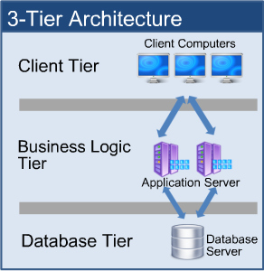
The Three-Tier Architecture:
To overcome the limitations of the two-tier architecture, an additional tier was introduced .The purpose of the additional tier (called as "middle" or "rule" tier) is to handle application execution and database management,
The three-tiers in a three-tier architecture are:
  Presentation Tier/client tier : Occupies the top level and displays information related to service available on a website. This tier communicates with other tiers by sending results to the browser and other tiers in the network.
  Application Tier/ business logic tier: Also called the middle tier, logic tier or business logic , this tier is pulled from the presentation tier. It controls application functionality by performing detailed processing.
  Data Tier: Houses database server where information is stored and retrieved. Data in this tier is kept independent of application servers or business logic.

Slide 14
Advantages:
  Improved Data Integrity: Data corruption through client application can be eliminated as the data passes through the middle tier for updating database ensures its validity.
  Enhanced Security :The placement of business logic on a centralized server makes the data more secure. data security is enhanced on service-by-service basis as the client does not interact with database directly.
  Hidden Database Structure: The actual structure of database often remains hidden from clients enabling any change in the database to be hidden
Limitations:
  Complexity of Communication: Usually more efforts should be ensured when creating 3-tier applications as the communication points are increased (client to middle tier to server) and the performance increased by tools like Visual Basics, Power Builder etc.

Slide 15
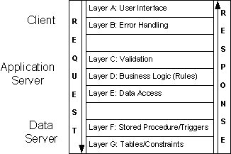
n-Tiers Architecture:
Often referred as Multitier Architecture. It is a client-server architecture in which presentation, application processing, and data management functions are physically separated. it is an expanded form of three-tier architecture.
Advantages:
It provides a model by which developers can create flexible and reusable applications. By segregating an application into tiers, developer acquires the option of modifying or adding a specific layer, instead of reworking the application.
Limitation:
Difficult to Implement: Due to componentization of tiers, the complex structure is difficult to implement or maintain.

